Slide 1
ONLINE BUS PASS SYSTEM AND TICKET SYSTEM
AN app/website to issue/renew bus pass online and book the tickets on the go.
By:-
17/49002- HARshita sohane
17/49013- Abhishek shukla
17/49025- ayush Agrawal
17/49027- Garima arora

Slide 2
certificate
This is to certify that Harshita Sohane,Garima Arora,Abhishek Shukla,Ayush Agarwal of BSc(H) Computer Science have successfully completed the project on Bus pass and online ticket system under the guidance of Mrs. Anita Goel and Mrs. Sheetal Taneja .
It is to further certify that this project is the individual and bonafide work of the candidates.

Slide 3
ACKNOWLEDGEMENT
Presentation inspiration and motivation has always played a great role in the success of any venture. We express our sincere thanks to our teachers Anita ma’am and Sheetal ma’am to encourage us to the highest peak and to provide us the opportunity to prepare the project. We are immensely obliged to our friends for their elevating inspiration , encouraging guidance and kind supervision in the completion of our project. We feel a deep sense of gratitude to our teachers whose valuable guidance and kind supervision given to us throughout the course which shaped the present work as its show.

Slide 4
1. INTRODUCTION
1.1 PROBLEM STATEMENT
i.) The current system of taking tickets in the buses
ii.) Applying or renewing for bus pass is a tedious process.
iii.) Takes long time for taking bus tickets
iv.)For bus passes, it involves a long queue in Bus Depot and it is a time consuming process.

Slide 5
1.2 WORKING OF PRESENT SYSTEM AND IT’S LIMITATIONS
i.) It quite tedious and hectic process
ii.) It will take time to generate bus pass and the passengers have to wait in long queue.
iii.)This existing online bus pass systems involves manual work. iv.)This long verification process causes delay to users in order to get their bus pass on time.

Slide 6
1.3 PROPOSED SOLUTION AND IT’S ADVANTAGES
Bus Pass and Online Ticket System can be used to book tickets on the go
Use to apply/renew the bus pass through smart phone, which helps all generation people.
It provides connection between government server, where data is managed and android app, which provides a GUI for the user.

Slide 7
Advantages:
Eliminate the need to stand in queues for passes or collecting ticket for each journey.
payment can be done through e-wallet or net-banking.
The user can issue the bus pass or renew the bus pass 24 hours a day.
You always have your ‘VIRTUAL BUS PASS’ with you all the time.

Slide 8
1.4 FEASIBILTY STUDY
TECHNICAL FEASIBLE:-
It is secured.
24*7 service available.
It is feasible to pay the amount online by using e-wallets, net banking etc instead of paying cash at the counter.
BEHAVIORAL FEASIBLE:-
Since, graphical user interface made is user friendly , it’s easy to use.
Not such special training is required in order to use it ,if one knows to use the smart phones.

Slide 9
1.5 SOFTWARE PROCESS MODEL USED: (Increment model)
Incremental Process suits the overall need of our application as we plan to launch our app in phases:
In the initial stage, we will allow the user to fill the details.
User then upload the documents.
It will get verified by admin and then a notification will be sent to user.
User then proceed with the payment and bus pass will get issued.
And side by side, admin will update the records od issuing/renewing the bus pass.

Slide 10
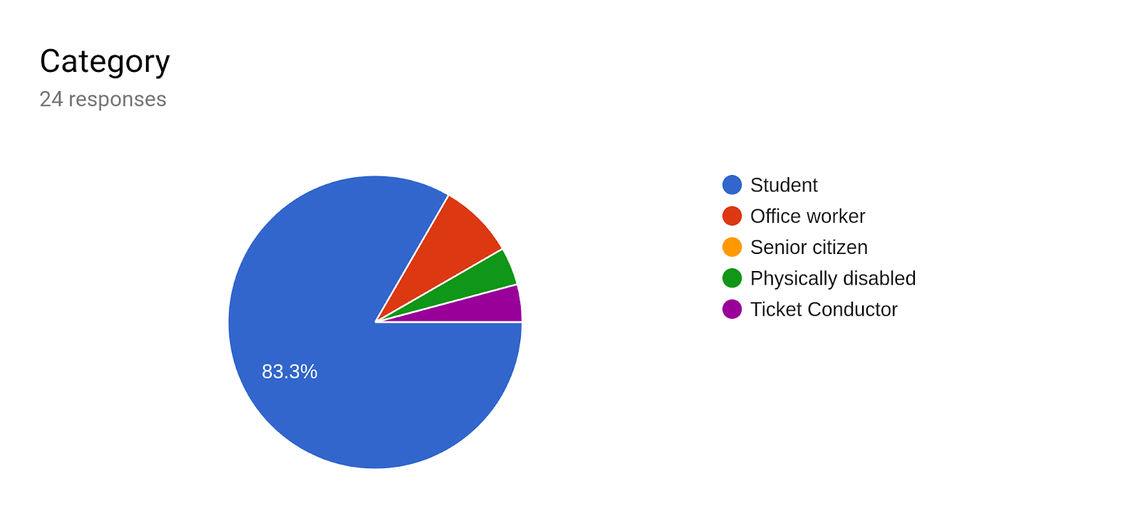
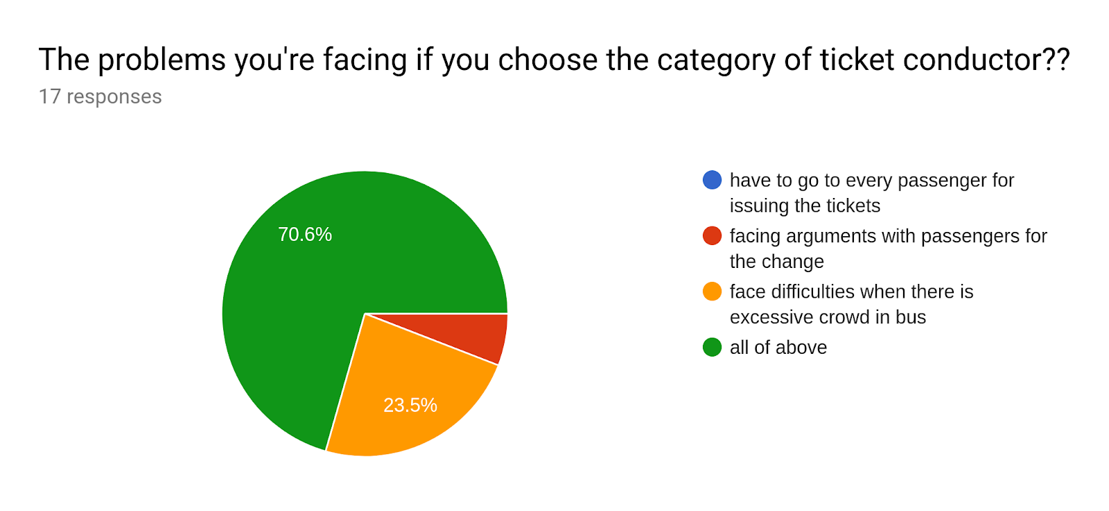
2.REQUIREMENT ANALYSIS
2.1 PRODUCT REQUIREMENTS:
GOOGLE FORM

Slide 11
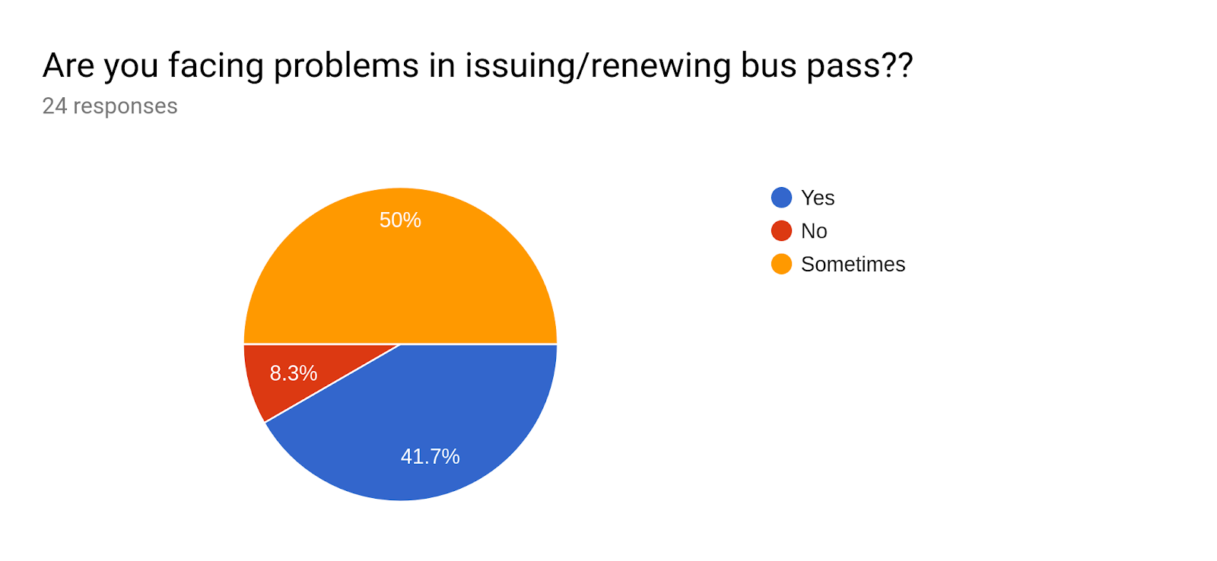
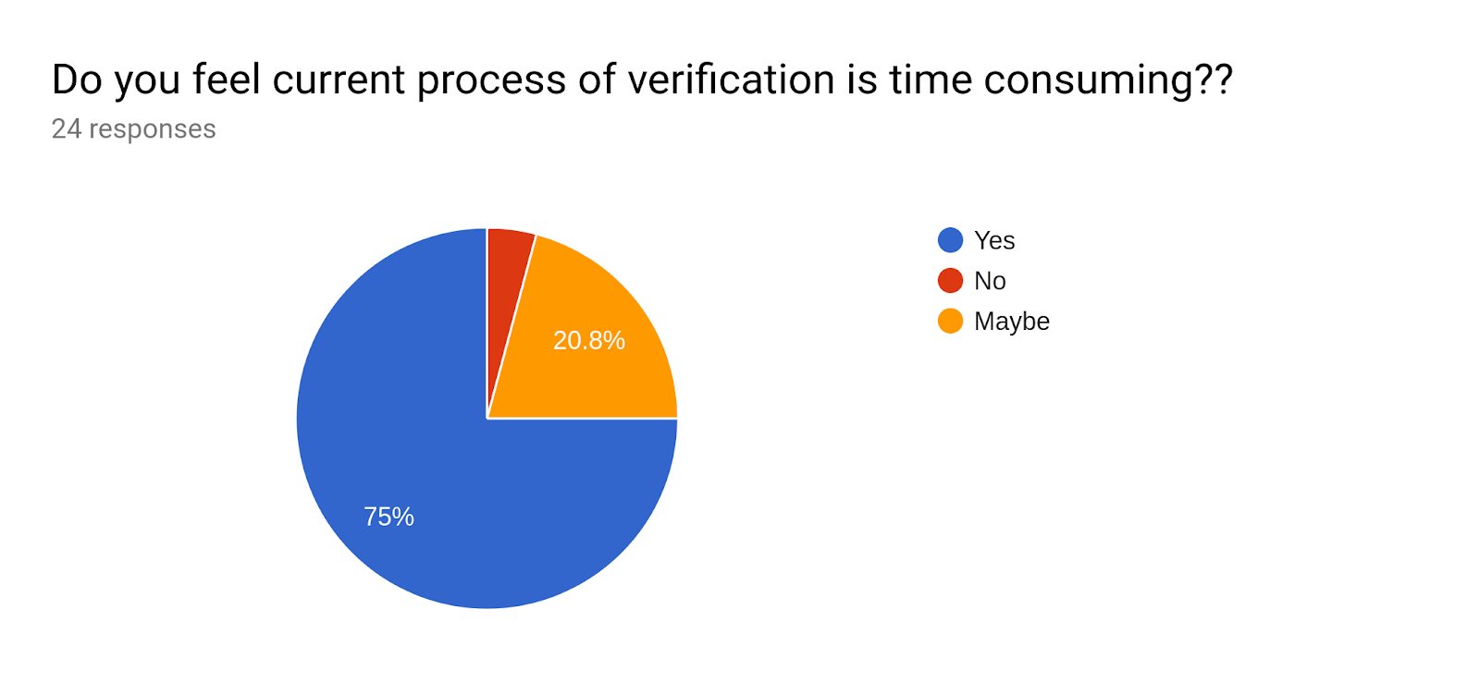
<- CURRENT SCENARIO
CURRENT SCENARIO PROBLEMS ->

Slide 12
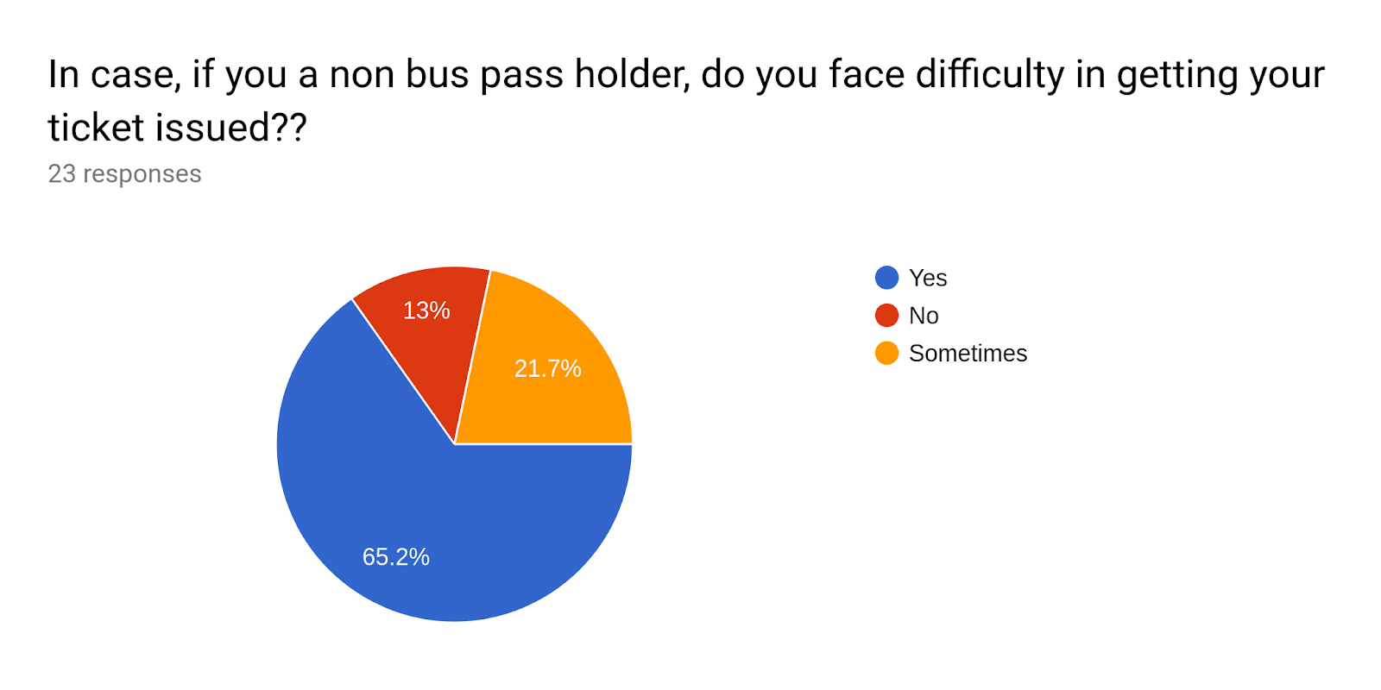
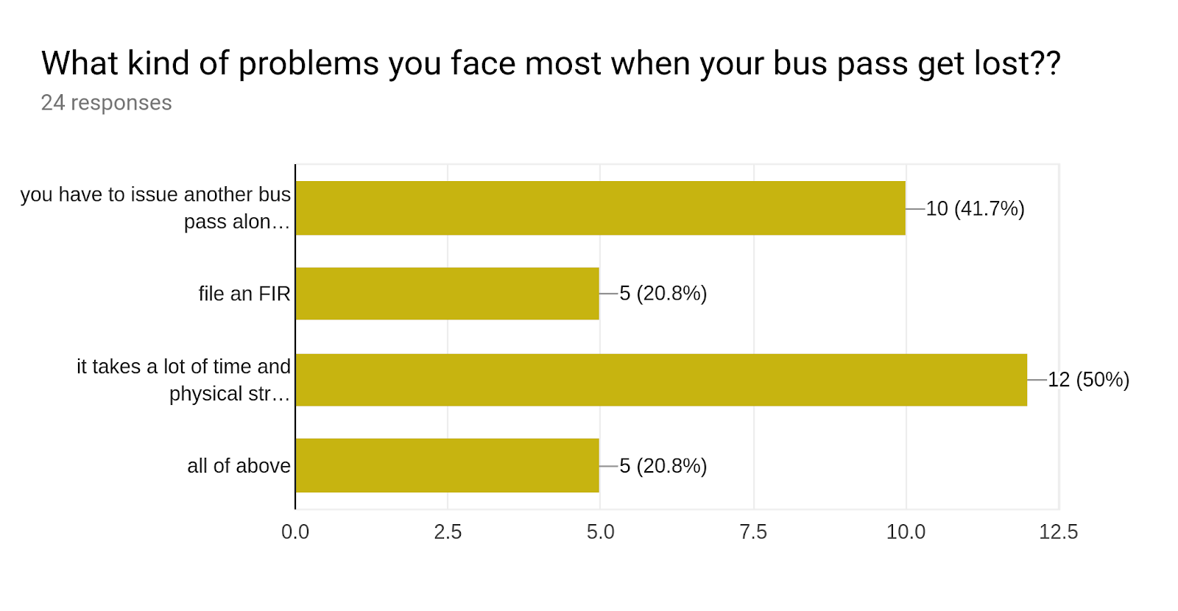

Slide 13
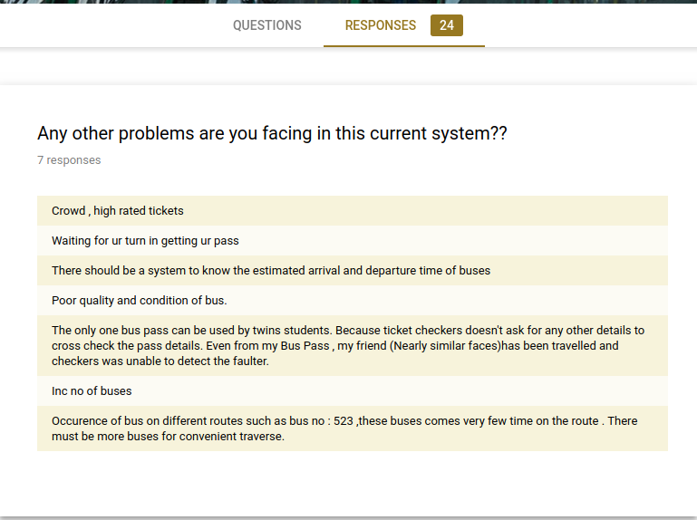
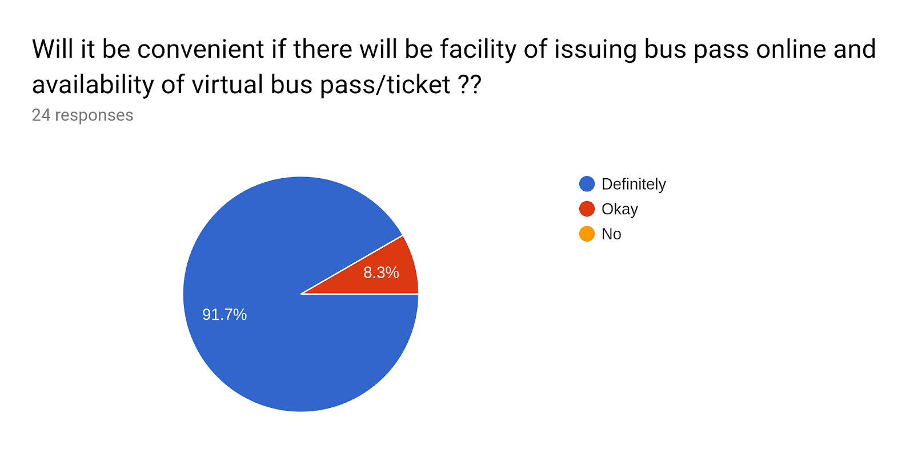

Slide 14
2.2 USER CHARACTERISTICS:
Beneficial for bus travelers.
The daily travelers are no more required to go to the bus depot
no need to worry for the change with ticket inspectors,
Users instantly book the ticket by scanning by the QR code printed on the bus , choosing the destination
Pay the required amount through the e-wallet.

Slide 15
2.4 ASSUMPTIONS AND DEPENDENCIES:
Authorization of government.
24*7 high internet speed.
Aware of using smart phones.
Maintenance of software.
Android phones are compatible with NFC feature.
It requires large database and memory.
The ticket collector make sure that every passenger entering into a bus either have a bus pass , or e-ticket , or buy ticket from him personally.
Implementing it for red buses and less crowded areas.

Slide 16
2.5 FUNCTIONAL REQUIREMENTS:
REGISTERED USER:
The user gets registered using Aadhar number, username ,password and email.
UPDATING INFORMATION:
As the user get authenticated for the bus pass /ticket, bus pass database should also get updated.
GENERATING BUS PASS:
After giving the necessary details for generation of buss pass, a soft copy of bus pass is generated with QR
ONLINE PAYMENT:
The payment for the transaction can be made directly through e-wallet or credit /debit card.
GENERATING QR CODE:
The copy of QR code will be created which will be scanned by ticket inspector.

Slide 17
2.6 NON-FUNCTIONAL REQUIREMENTS:
RELIABILITY:
no chances of concurrency.
AVAILABILITY:
Application will be working 24*7.
more user friendly due to better graphical user interface.
SECURITY:
The ticket is provided with a QR code .
The QR code contains the link to the government server in an encrypted form
And contains the identity of the passenger as gathered from aadhar card.
provides better security.

Slide 18
2.7 DATA REQUIREMENTS:

Slide 19
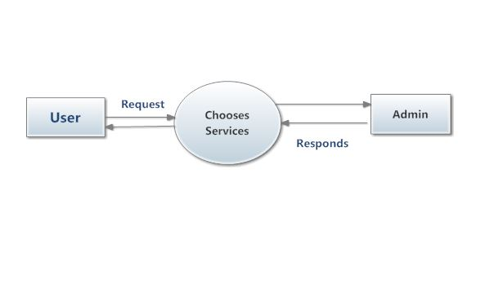
2.8 DATA FLOW DIAGRAM
LEVEL 0:-

Slide 20
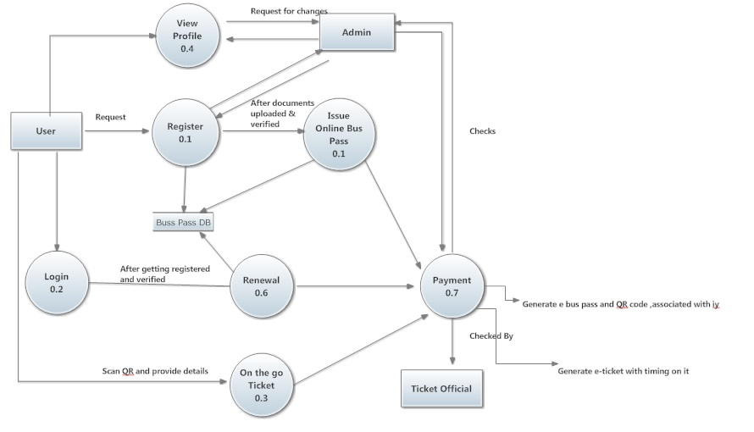
LEVEL 1:

Slide 21
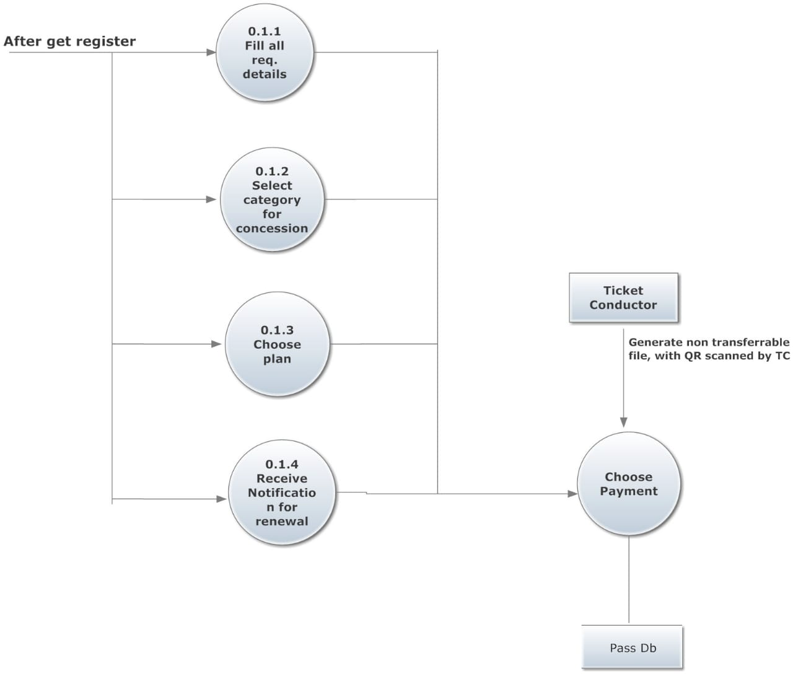
LEVEL 2:

Slide 22
3. PROJECT MANAGEMENT
3.1 RISK MANAGEMENT AND ANALYSIS
1. CATASTROPHIC:-Failure to meet the requirement would result in mission failure.
2.CRITICAL:-Failure to meet the requirement would degrade system performance to a point where mission success is questionable.
3.MARGINAL:-Failure to meet the requirement would result in degradation of secondary mission.
4.NEGLIGIBLE:-Failure to meet the requirement would create inconvenience or non operational impact.

Slide 23
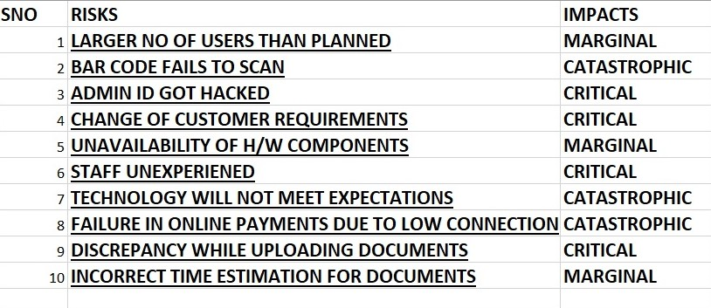

Slide 24
3.3 FUNCTIONAL POINT ANALYSIS
1. ESTIMATION
2. UNADJUSTED FUNCTION POINT
Functional Type | Simple | Average | Complex
External Input | 3 | 4 | 6
External Output | 4 | 5 | 7
External Inquiry | 3 | 4 | 6
Internal Logical Files | 7 | 10 | 15
External Interface files | 5 | 7 | 10
Domain | Count*Complexity | Func point count
External Input | 3*4 | 12
External OutPut | 3*5 | 15
External Inquiries | 2*4 | 8
External Interface Files | 2*10 | 20
Internal Logical Files | 1*7 | 7
Count total= 62

Slide 25
VALUE ADJUSTMENT FACTOR
0:No incidental
1:Incidental
2:Moderate
3:Average
4:Significant
5:Essential
S.No | Value Adjustment Factor | Score
1 | Does the system require reliable backup and recovery? | 5
2 | Are specialized data communication required to transfer information to or from the application? | 4
3 | Are these distributed processing functions? | 4
4 | Is performance critical? | 0
5 | Will the system run in an existing , heavily utilized operational environment? | 2
6 | Does the system require online data entity? | 5
7 | Does the online data entry require the input transaction to be built over multiple screens or operations? | 2
8 | Are the ILFs updated online? | 4
9 | Are the inputs , outputs , files, or inquiries complex? | 1
10 | Is the internal processing complex? | 2
11 | Is the code designed to be reusable? | 3
12 | Are conversation and installation included in the design? | 2
13 | Is the system designed for multiple installation in different organisations? | 0
14 | Is the application designed to facilitate change and use by the user? | 4
 | Sum (∑Fi) | 38
Function point=Total count*[0.65+0.01*∑Fi]
=62*[0.65+0.01*38]
=62*[0.65+0.38]
=62*[1.03]
=63.86

Slide 26
4. DESIGN
Create table account_pass(
Username varchar(20) Not NULL ,
Password varchar(20) Not Null,
Email_id varchar(20) Not Null,
Aadhar_no integer(12) Not Null,
Primary key(Username , Password)
);
4.1 DATA DESIGN
Create table userinfo(
Resident_addr varchar(20) Not Null,
Phone_no integer(20) Not Null
Category varchar(20) Not Null,
Validity_time date Not Null
);
Create table pass_info(
Name varchar(20),
Address varchar(20),
Validity date(20),
Bus_pass_no integer(20) primary key,
Foreign key(Name) references account_pass(Aadhar_no),
Foreign key( Validity) references userinfo(Validity_time)
);
Create table student
(
Name_inst varchar(20) Not Null,
Code_no integer(20) Not Null,
Roll_no integer(20) Not Null,
Student_idno varchar(20) Not Null , Primary key
);

Slide 27
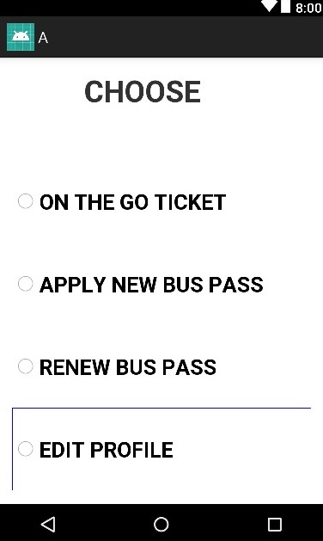
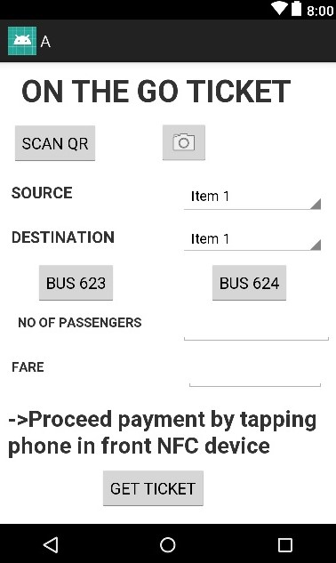
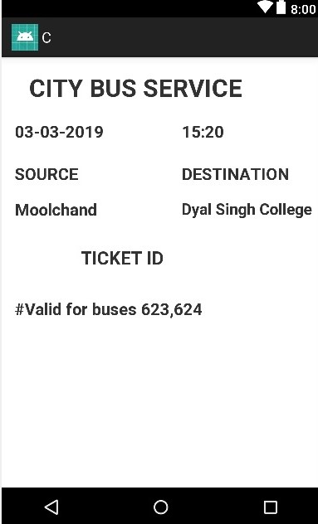
4.3 INTERFACE DESIGN:

Slide 28
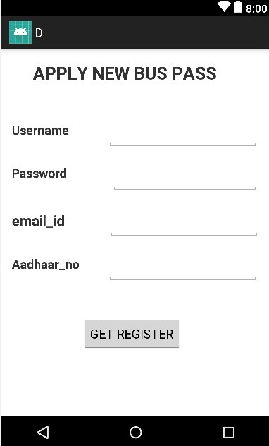
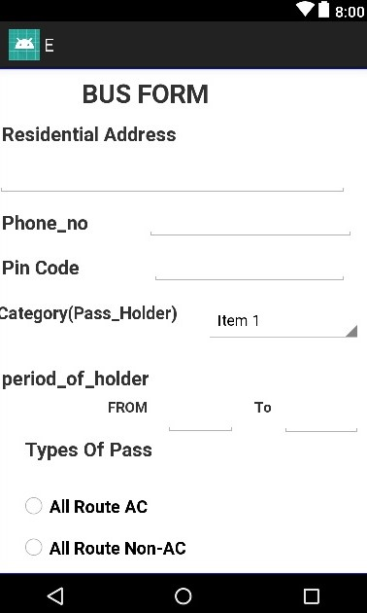
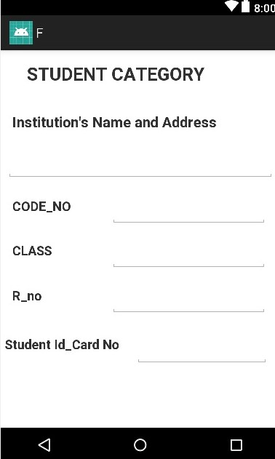

Slide 29
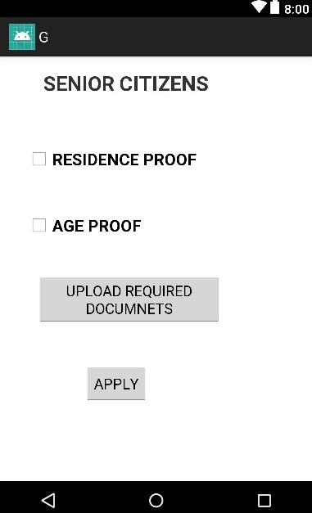
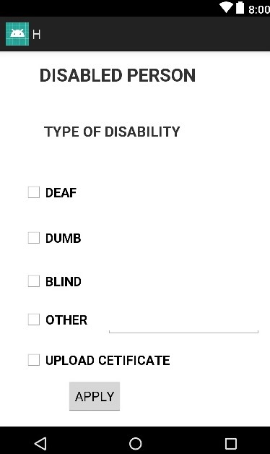
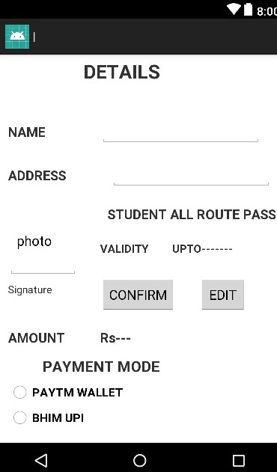

Slide 30
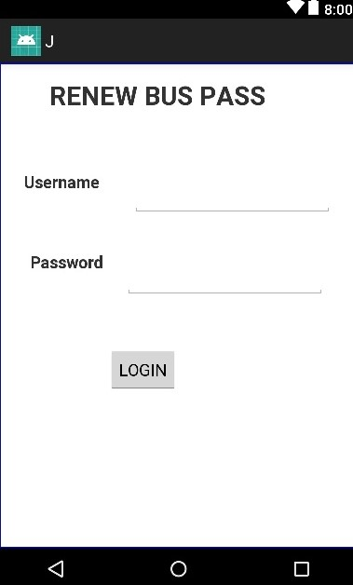
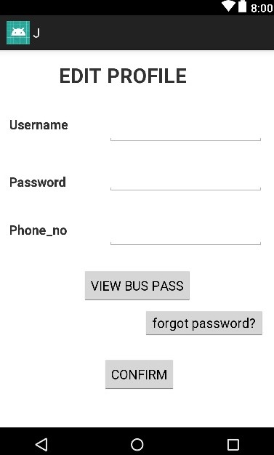

Slide 31
5. TESTING
5.1 TEST CASES
TEST CONDITIONS | ENTERED INPUT | EXPECTED RESULT
1. | User register with new id and password | Registration will successful
2. | User Register with existing id | Registration will not done
3. | User register with invalid password | Registration will not done
4. | During Registration aadhar card details don’t match with the filled details . | Requested to enter the aadhar card again.
TEST CASE:1
REGISTERED ACCOUNT
TEST Conditions | Entered Input | Expected Output
1 | User Enters a Valid ID With valid password | Login Successful
2 | User Enter a Invalid ID | Login Unsuccessful
3 | Entered Password is Wrong or Doesn't match the password in database with the respected ID | Login Unsuccessful
4 | User forgets password and clicks on Forget Password Option. | Redirected to new link to recover Password
Examples: | Invalid ID: Xyz @... XYZ!@... PASSWORD IS INVALID WHEN IT DOESN’T MATCH THE DATABASE | Login Unsuccessful
TEST CASE:2
LOGIN ACCOUNT

Slide 32
Test Conditions | Expected Input | Expected Output
1 | Passenger tap Nfc tag on the bus stop,enter destination | Show the buses which goes to that destination
2 | Passenger enter destination,that does not exist | Doesn’t show any destination
3 | User enter in bus and again scan NFC for check In | Check In time will be started
4 | User scan improper NFC in bus | Check time will not be started
5 | User scan NFC of other route bus | Show error and check time will not be started
TEST CASE:3
ON THE GO TICKET
Test conditions | Expected Input | Expected Output
1 | Enter correct username , aadhar no etc. by the user. | Proceed
2. | Redundancy in aadhar number | Does not proceed
3 | Upload required documents | Gets verified
4. | Discrepancy in the documents uploaded | Does not gets verified.
5 | Payment successful | Pass issued
6 | Failure of payment | Pass not issued
TEST CASE:4
APPLY FOR NEW BUS PASS

Slide 33
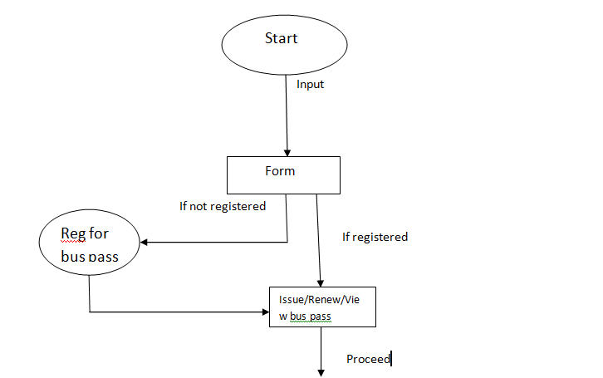
Cyclomatic Complexity
No of edges: 5
No of Nodes: 4
No of connected components:2
Cyclomatic complexity:E-n+2*P=2

Slide 34
Thank You

